Slide 1
Stay Alive: Family based, HIV/AIDS Prevention program helps solve mdg puzzle
Presented by: Michelle Stone
Reach the Children, Inc.
Approved Date 3/2014: Reach the Children, Inc

Slide 2
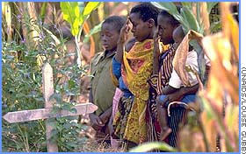
HIV/AIDS FACTS
The HIV/AIDS pandemic continues to decimate the families and communities of sub-Saharan Africa
Nearly 18 million children are HIV/AIDS orphans (UNAIDS 2012)
2012 - sub-Saharan Africa accounted for 70% of the global total of 35.3 million people living with HIV, and three quarters (75%) of all AIDS related deaths (UNAIDS (2012)

Slide 3
WINDOW OF OPPORTUNITY

Slide 4
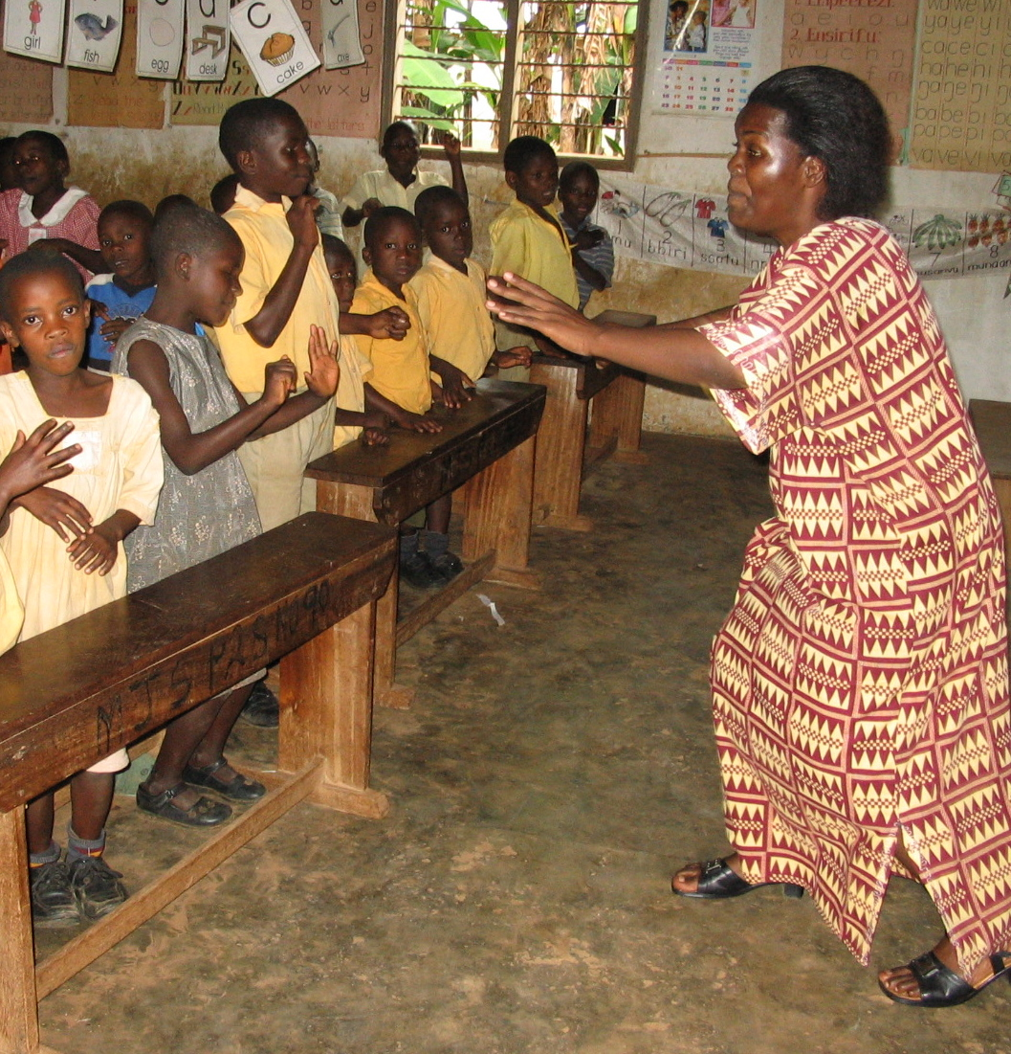
What is STAY ALIVE?
Stay Alive is an HIV/AIDS prevention education program.
Founded in 2002 by United Families International in partnership with Susan Roylance and author Wendy Sheffield, LCSW
Reach the Children, Inc. is solely responsible for administration and implementation of the Stay Alive program
The program has been taught to over 2 million children in 14 African Nations

Slide 5
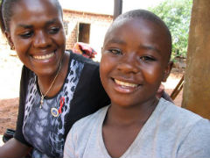
STAY ALIVE ADDRESSES HIV/AIDS (MDG #6)
Family based - helps build the parent/child relationship to reinforce important lessons about life saving choices of abstinence and fidelity taught in schools, churches and community centers
Consequential thinking skills - taught to children before they become sexually active between the ages of 9-14 and focuses on how they can protect their current and future families by remaining HIV/AIDS free
Stay Alive Provides Hope!

Slide 6
STAY ALIVE WORKS!
Final Evaluation Results:
(Report by Panos, Panos, and Cox, The International Center for Child and Family Resiliency 2009)

Slide 7
SCHOOL OUTSIDE KISUMU, KENYA - ADMINISTRATOR
Notes:
SCHOOL OUTSIDE KISUMU, KENYA - ADMINISTRATOR
“Most of the families – all these homes – there isn’t a home that has not buried an AIDS victim. At times they can die two in a week. You bury here and after one week another parent is dead. You bury there, and after one week the mother who was left with the children has died; the children left total orphans. So bury, bury, bury, bury.
Most of these orphans, total orphans, who are left behind by people who have been taking care of them. What they engage in for survival is prostitution. They become very promiscuous.
The SA program has made a lot of difference. Last year I had seven girls that were pregnant. But because of this SA program these early pregnancies have been reduced to zero.
These are some of the positive changes we are seeing in children. They are now with a lot of love, and hope and life.
Even the orphans that had thought that being orphaned is the end of the road, they now feel life after orphanhood.

Slide 8
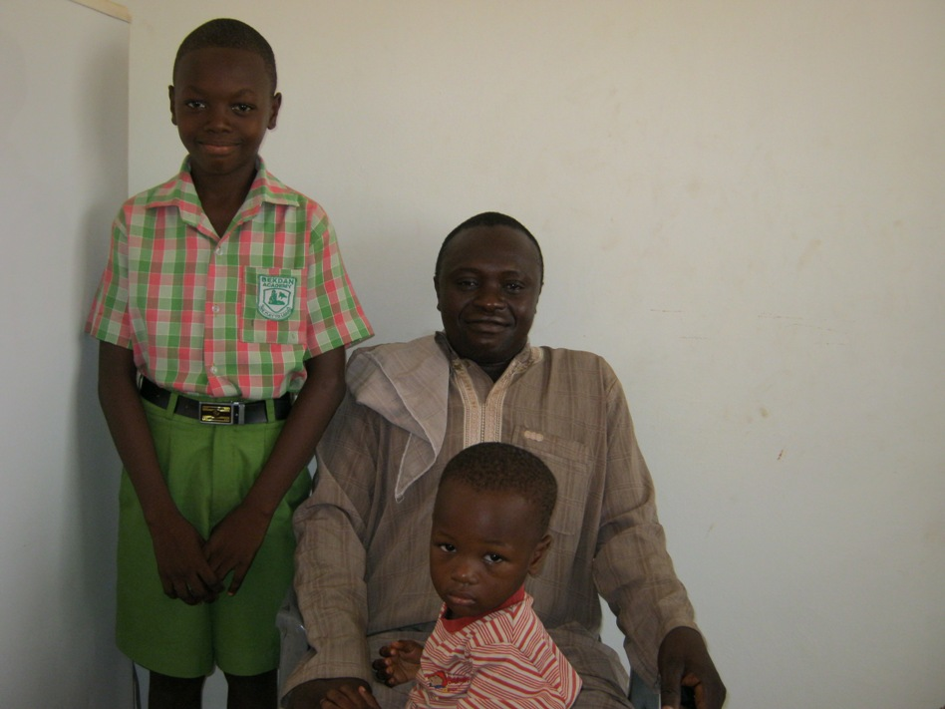
Additional Evaluation Findings
Children demonstrated a statistically significant improvement in understanding how HIV/AIDS is transmitted.
There is a statistically significant improvement in the level of communication that parents (care-givers) are having with their children regarding sexual matters as well as all topics.
Parent feedback: “It has made life easier for me. I’ve never talked to my children about issues of sexuality, but Stay Alive has become the bridge, and it has opened up, and now I can interact with my children.”
(Panos, Panos, and Cox, ICC&FR, 2009)

Slide 9
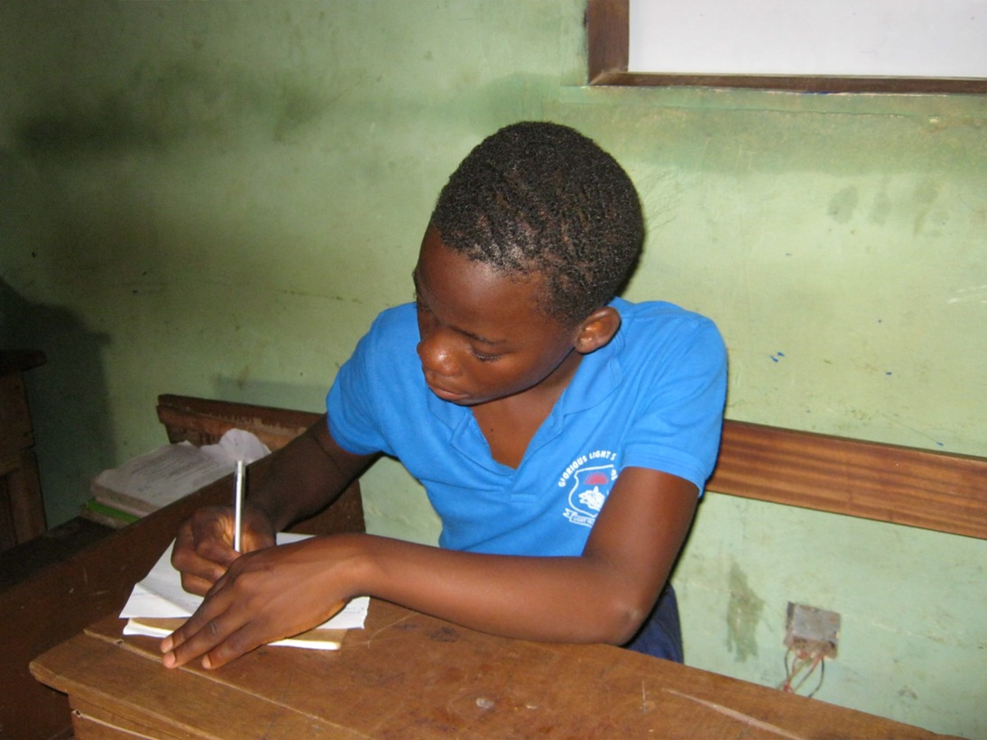
Regina Osaabou, a Primary 6 student, in Ghana writing about Stay Alive
Notes:
How Stay Alive has helped me and my family.
After I had been taught about how HIV/AIDS infects people, I tried to discuss it with my elder sister and it has helped us a lot. It has showed us how to stay away from the bad infection of HIV/AIDS. I also discussed it with my parents and they asked me questions about it. I answered them and they understood it. It is really helping people. It is giving us the ways of preventing HIV/AIDS. In Ghana, people think that those who are infected with HIV/AIDS are not human, but I think that we should treat them with respect, protect and love them.

Slide 10
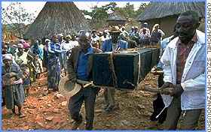
HIV/AIDS AND POVERTY
Almost 5,000 people die every day due to AIDS
AIDS caused 1.6 million deaths in 2012 (AIDS.org)
An estimated 36 million people have died from HIV-related causes since the beginning of the pandemic (AIDS.org 2012)
Approximately 95% of people living with HIV/AIDS live in low- and middle-income countries (AIDS.org 2012)

Slide 11
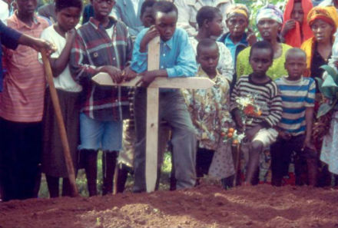
HIV/AIDS AND POVERTY
“If we didn’t have HIV/AIDS we would have more wealth”
By 1995, more than $75 billion had been spent on AIDS
Average of $10 billion per year since 1995

Slide 12
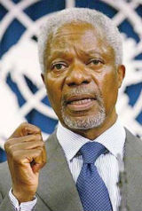
HIV/AIDS AND POVERTY
Kofi Annan, the former United Nations
Secretary-General, stated in 2001:
“We must make sure that girls –- who run a particular risk of infection -- have all the skills, the services and the self-confidence to protect themselves
Across all levels of society, we need to see a deep social revolution that transforms relationships between women and men, so that women will be able to take greater control of their lives -- financially as well as physically”

Slide 13
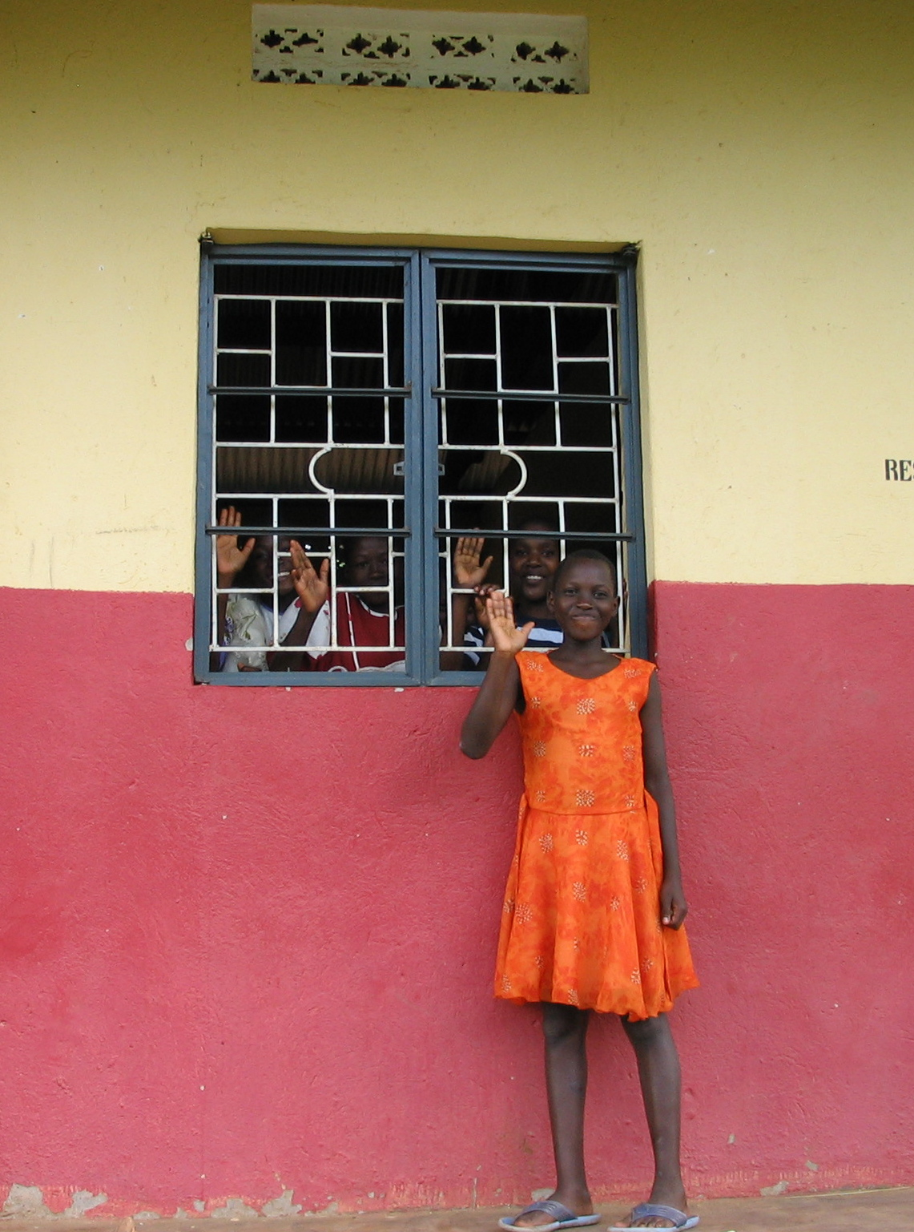
STAY ALIVE Addresses Poverty (MDG #1)
Children demonstrated an increase in self-efficacy in regard to their ability to avoid contracting HIV and AIDS - giving them hope to not be condemned to a life of illness and poverty (Panos, Panos, & Cox, ICC&FR 2009)

Slide 14
Sara’s Story
Notes:
SARA’s Story – PARENT
The Stay Alive Program has really affected my children because they now know what they have to do in their lives. They know they are important, they know that they are now worthy to the community or even to us as parents, to the school, or the country as a whole. And they now know how to make the right or wrong choice and they know the consequences.
You know as we are in this slum, most of the children are being abused. Because they don’t have something to give to their kids, mostly those who are single parents, there are those who use their kids to move with men to bring food, or the daily bread at home.
But due to the Stay Alive program we have had here at the school, my kids know what is right and what is wrong. They know the outcomes of the choices they always make.
My first born was challenged by a boy. He wanted my daughter to be his ‘friend.”
After getting the Stay Alive Education Program I decided to sit with her and we exchanged minds. I told her about how the bad choices would result in her future life. I showed her how important she is to the family and to the country, and I also let her know about her future, happy family. And this could only come after she first respected herself, worked hard in class, got her education, and abstained until she got married.
Now she also advises others. I recently visited her school…I was welcomed to the school by a lot of girls, and finally they told me that my daughter is of great use to them. She always gathers them together and shows them the importance of respecting themselves and what will be their future.
Therefore, the Stay Alive Program helps a lot in my life and in the lives of those we are close in the community.

Slide 15
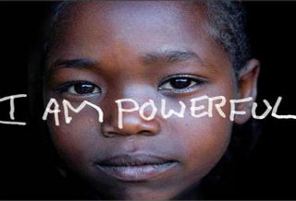
STAY ALIVE EMPOWERS WOMEN AND ADDRESSES GENDER EQUALITY (MDG#3)

Slide 16
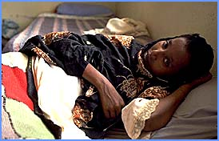
HIV/AIDS and Women
HIV/AIDS disproportionately affects women
58% of HIV-positive women live in sub-Saharan Africa
HIV infection rates occur at a rate twice as high for young women as young men ages 15-24 yrs. old (UNAIDS 2012)
“Each minute one young woman acquires HIV, accounting for 22% of all new HIV infection with sexual transmission being the dominant mode of infection” (Women Out Loud, UNAIDS 2012)

Slide 17
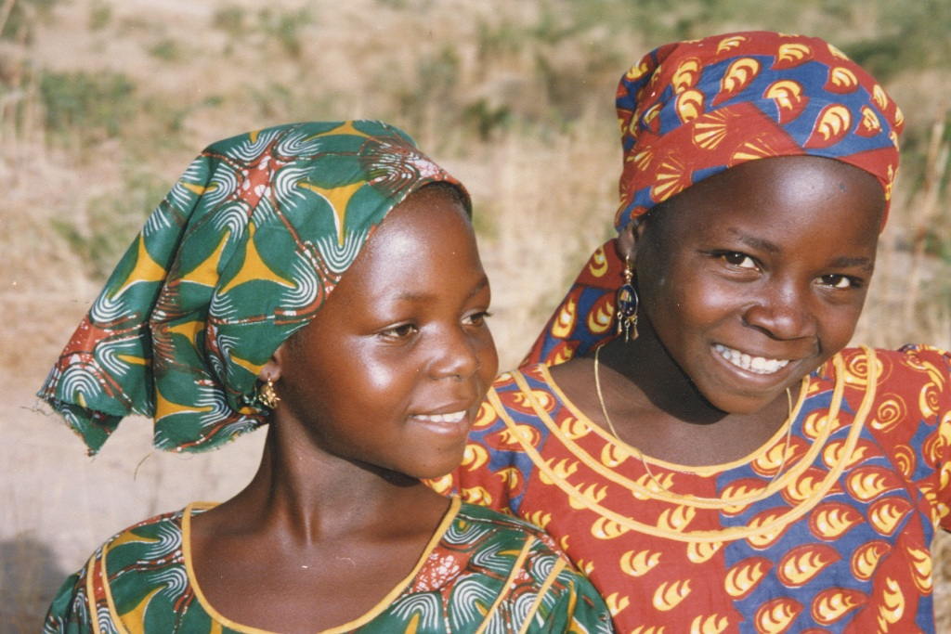
STAY ALIVE EMPOWERS YOUNG WOMEN
Young Women reported a statistically significant change in perception regarding their ability to resist sexual advances by males; and young men reported a statistically significant change in perception regarding their willingness to accept such resistance. (Panos, Panos, & Cox, ICCF&R 2009)
“I can make my own choice. I can be a girl. I am not somebody’s woman. I want to be a girl.”

Slide 18
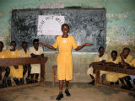
STAY ALIVE HELPS ACHIEVE UNIVERSAL PRIMARY EDUCATION (MDG #2)
“Most of the students were dropping out of school around class 6 or 7, especially the girls. This year, we are proud to say that we don’t have a drop out. …So there is positive change with Stay Alive” Cloudy School Administrator in Kenya.

Slide 19
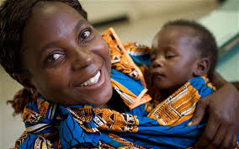
STAY ALIVE HELPING WITH OTHER MDGs
Lowering the HIV/AIDS rate will:
Improve maternal health (MDG #5)
Reduce child mortality rates (MDG#4)

Slide 20
STAY ALIVE – A FAMILY BASED PROGRAM HELPS SOLVE THE MDG PUZZLE
MDG #1 Eradicate extreme poverty and hunger
MDG #2 Achieve universal primary education
MDG #3 Promote gender equality and empower women
MDG #4 Reduce child mortality rates
MDG #5 Improve maternal health
MDG #6 Combat HIV/AIDS, malaria and other diseases

Slide 21
STAY ALIVE = HOPE “I WILL LIVE A LONG, LOVING LIFE”

